Slide 1
Understanding species richness and rarefaction
Proposal project BIOL709b
Elske Tielens

Slide 2
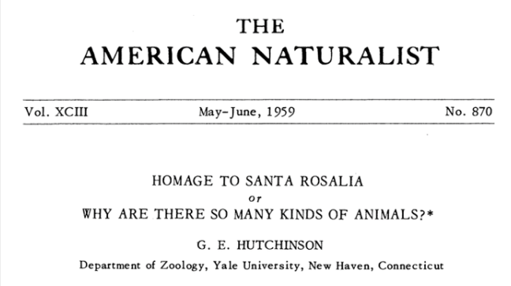

Slide 3
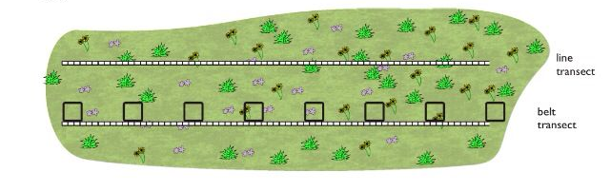
From: Pinterest, user The Educationist

Slide 4
Sampling is not complete
Spatial autocorrelation
From: Pinterest, user The Educationist

Slide 5
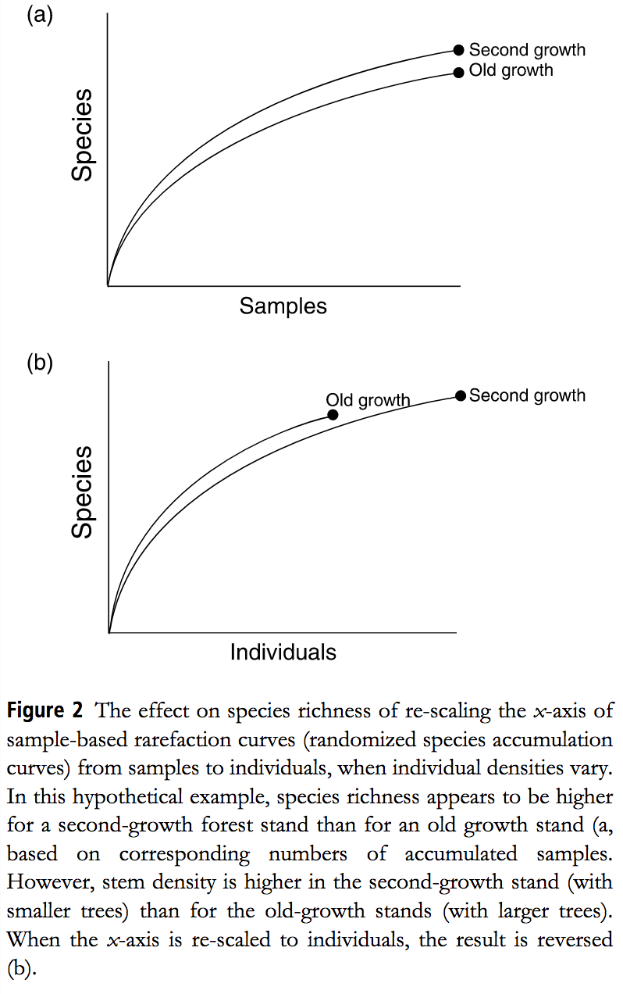
Solution:
Gotelli & Colwell, Ecology Letters 2001
Notes:
The solution for this is a rarefaction curve:
But results may differ depending on how you rarefy
Standardizing data sets by area or sampling effort may produce very different results compared to standardizing by number of individuals collected, and it is not always clear which measure of diversity is more appropriate. Asymptotic richness estimators provide lower-bound estimates for taxon-rich groups such as tropical arthropods, in which observed richness rarely reaches an asymptote, despite intensive sampling.

Slide 6
Observed richness is driven by:
Regional richness
Number of individuals
Evenness distribution
Aggregation of conspecifics
Notes:
. Numbers of individuals (i.e., density effects) 2. The distribution of rarity and commonness (i.e., the SAD) 3. The spatial patchiness or aggregation of conspecifics.

Slide 7
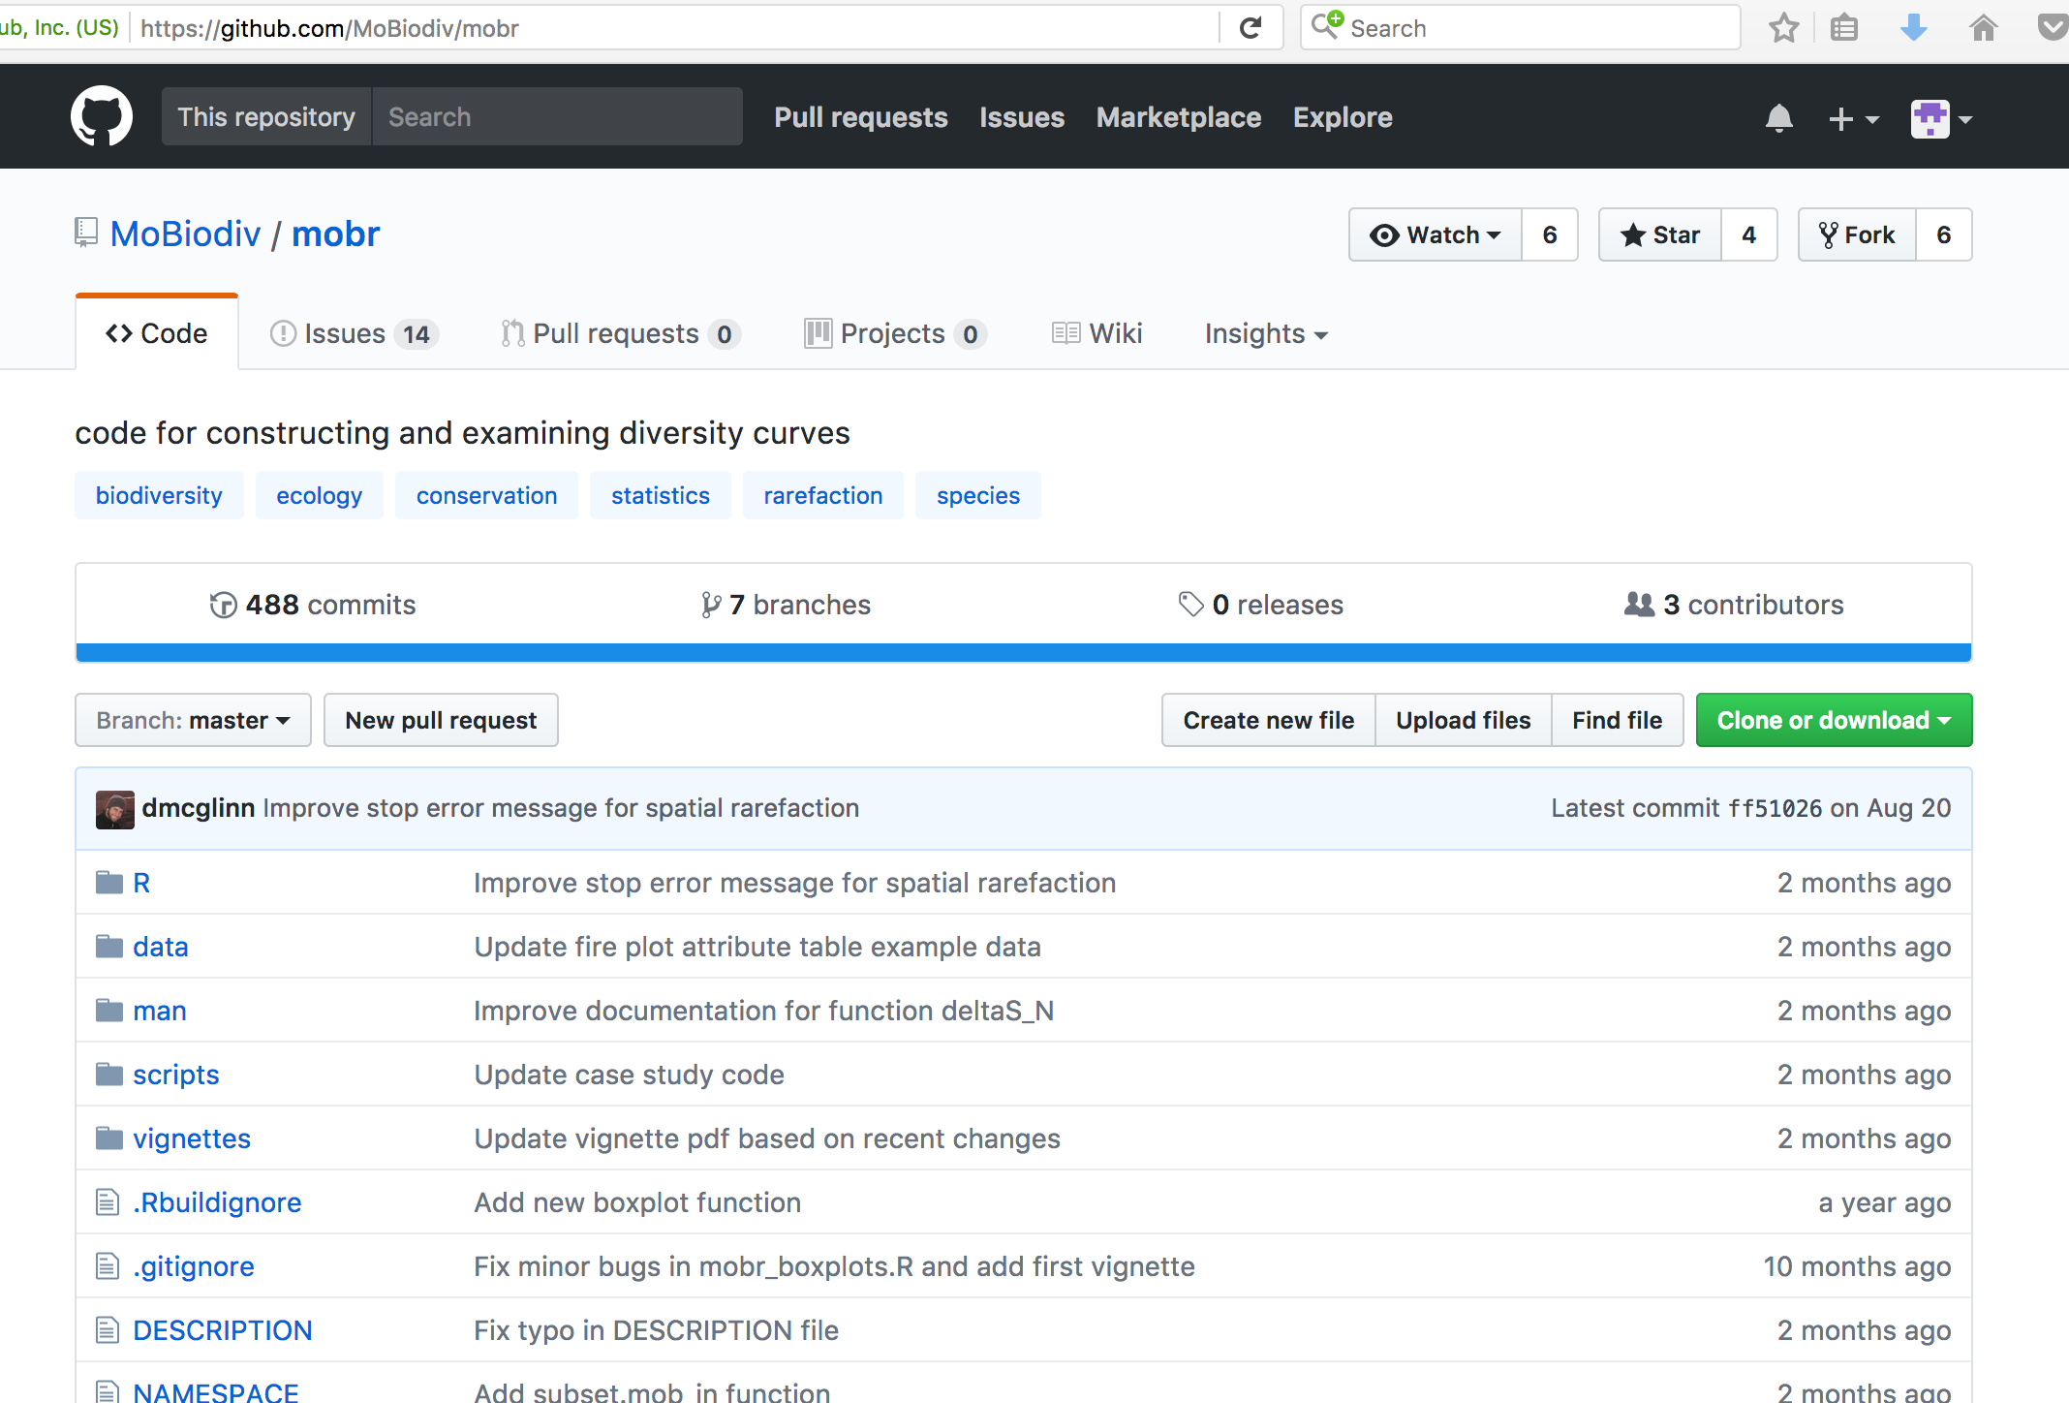
Developers:
Dan McGlinn
Felix May
Xiao Xiao

Slide 8

Point and click >> true function going ons are hidden
My aim is to bring forward the code behind the package, apply to my data, and annotate to be able to find problems
Notes:
Creators of the package aimed to make it as close to click and point as possible
Because so much happens backstage, and it’s a new package, this means that when you have a problem it’s almost impossible to troubleshoot
My aim is to bring forward the code behind the package, apply to my data, and annotate to be able to find problems

Slide 9
Workflow:
Get data in the right format
Run data examples in
mobr package
Exploratory plotting:
Calculate richness, SAD
Create spatial, nonspatial
and individual rarefaction curve
Extract functions from mobr package
Annotate mobr functions to
produce ‘dummy-proof’ code
Calculate rarefied richness difference between treatments across samples/individuals
Plot these values against sample n
Hand code similar functions (annotated function can function as cheatsheet)
Calculate difference between
spatial, nonspatial and
individual rarefaction
Interpret results
Notes:
Of course when I code similar functions, I will omit creating the side code that helps it troubleshoot and assume you do this with data that it works with.
However, individuals are almost never randomly distributed in space, either due to heterogeneity of environmental factors or non-random dispersal of individuals. Thus, it is necessary to develop rarefaction methods that account for such non-random distributions.

